Slide 1
IBM Applied Data Science Capstone Project
Battle of the Neighborhoods

Slide 2
Best Indian Restaurants
Where are all the best Indian restaurants in New York?
Which Boroughs have the best Indian restaurants?
A local travel agency wants to take tourists to popular Boroughs that have the best Indian restaurants
Are some of the best rated Indian restaurants in Manhattan or other Boroughs?
I want to open a new Indian Restaurant and want to know which boroughs have the best rated ones – find a borough that may not have much competition

Slide 3
Business Problem
Identify the boroughs/neighborhoods in New York that have the best rated Indian restaurant (Rated 8.0 & higher)

Slide 4
Approach
Identify the data set – Foursquare
Understand the data
Collect the data
Preprocess the data
Prepare the data
Modelling
Analyze the output
Prepare final summary

Slide 5
Final Output
Identify the clusters of boroughs in New York neighborhood that has the Indian restaurant's rated >8.0

Slide 6
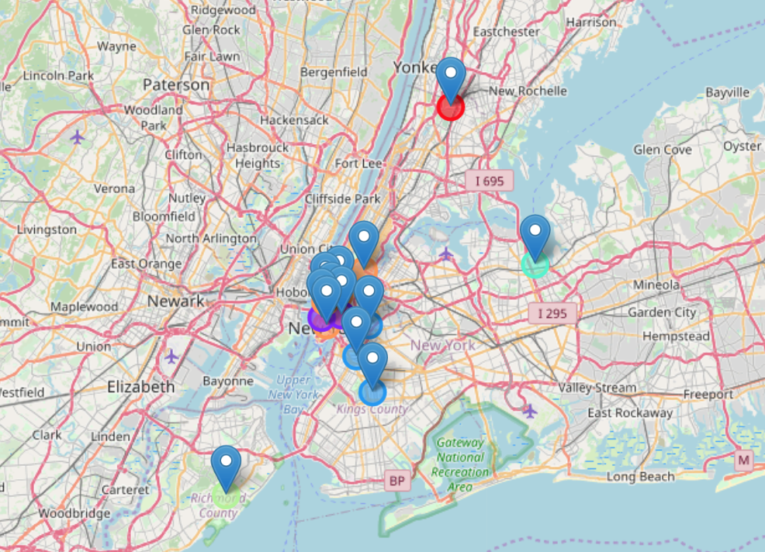
Final Output

Slide 7
Final Summary
Manhattan has restaurants rated 8.8 & higher
Manhattan also has restaurants rated >= 8.2 & < 8.8
Brooklyn has the next best rated restaurants >=8.5 & <= 8.7
Other clusters include Bronx, Queens, Staten Island

Slide 8
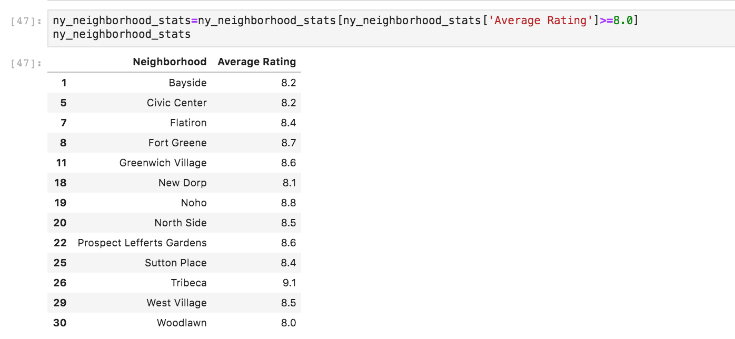
Identify neighborhoods with restaurants rated 8.0 & higher

Slide 9
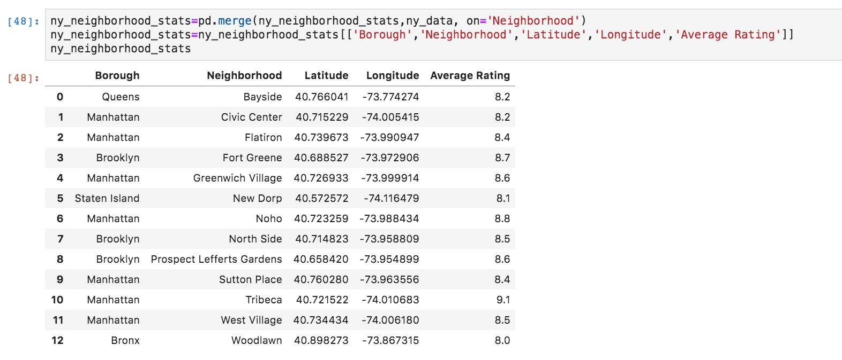
Map data to NY borough’, get other key data

Slide 10
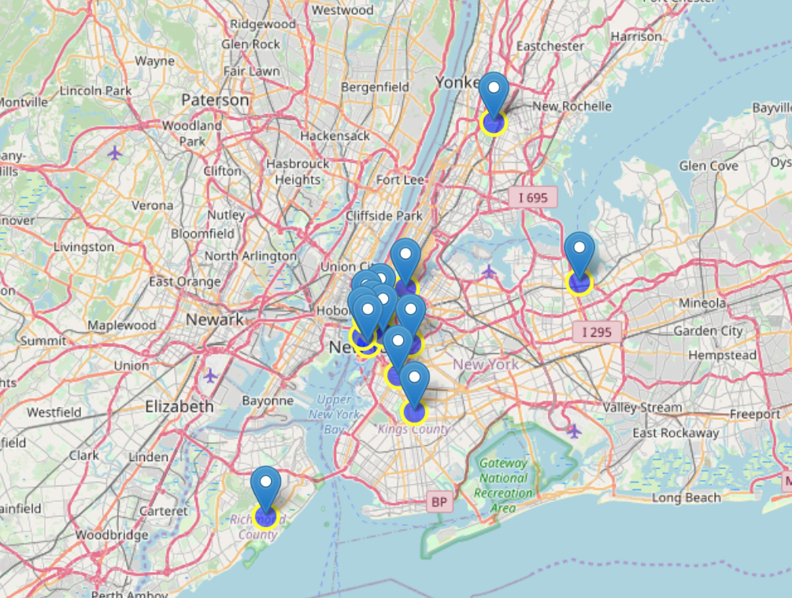
Map the data

Slide 11
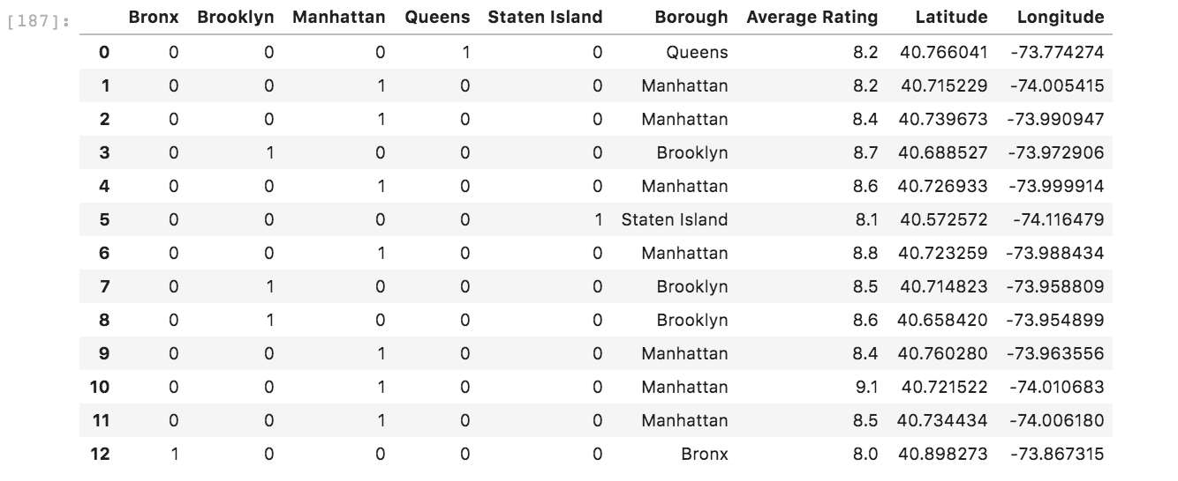
Prepare Data

Slide 12
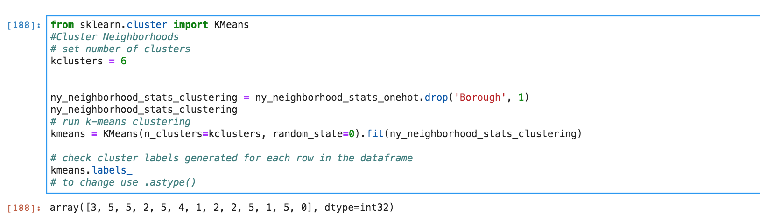
Cluster Data

Slide 13
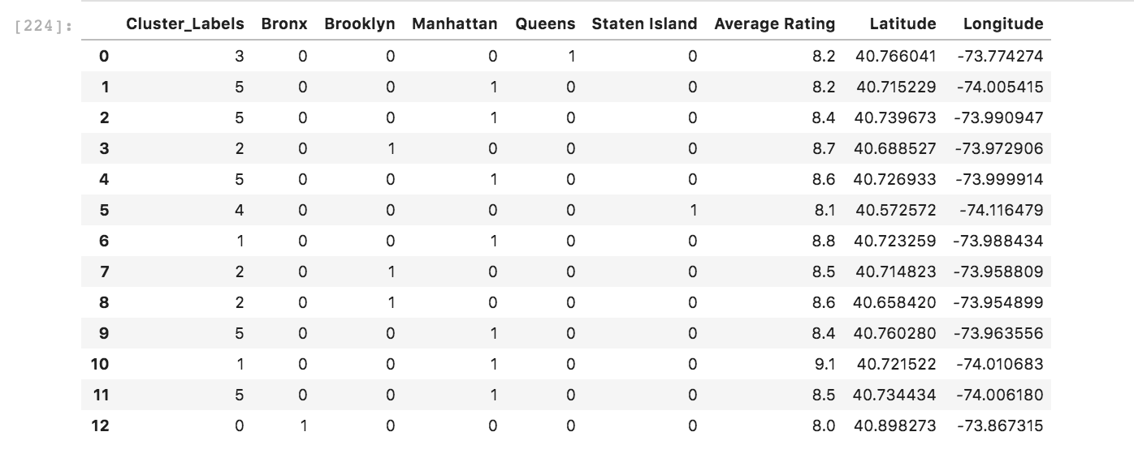
Review Output

Slide 14
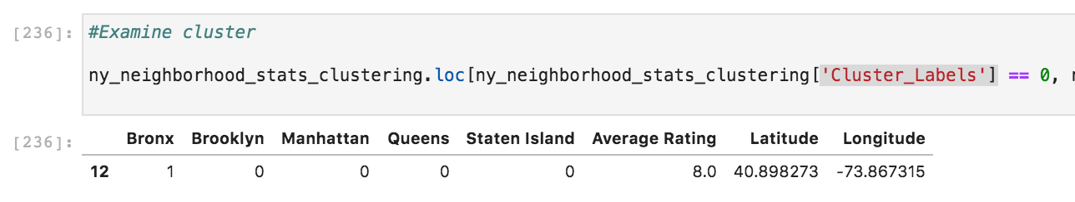
Examine Cluster #1

Slide 15
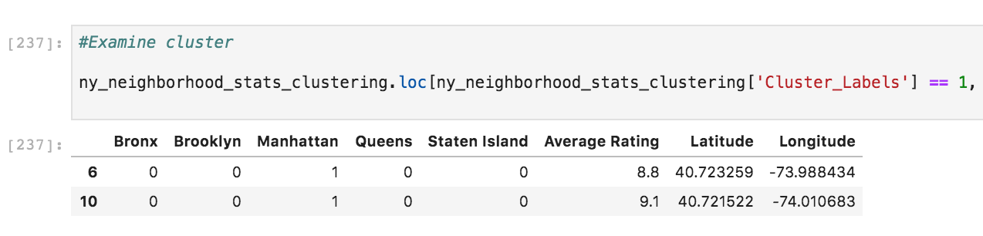
Examine Cluster #2

Slide 16
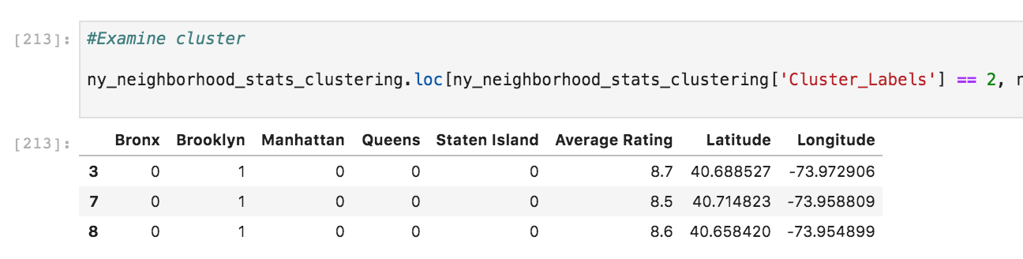
Examine Cluster #3

Slide 17
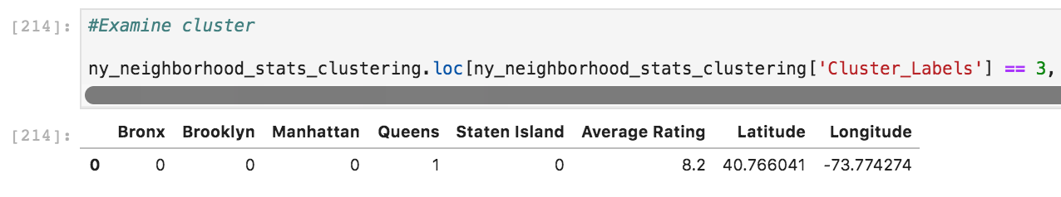
Examine Cluster #4

Slide 18
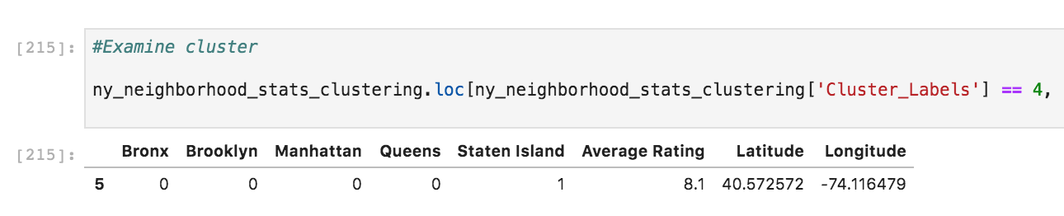
Examine Cluster #5

Slide 19
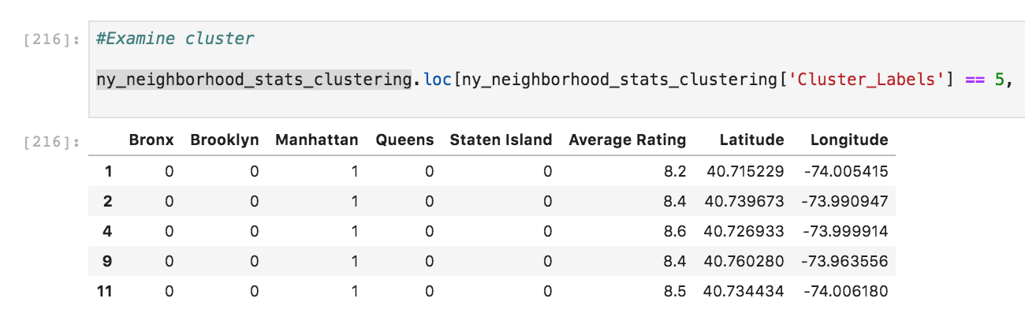
Examine Cluster #6

Slide 20
Map Clusters

Slide 21
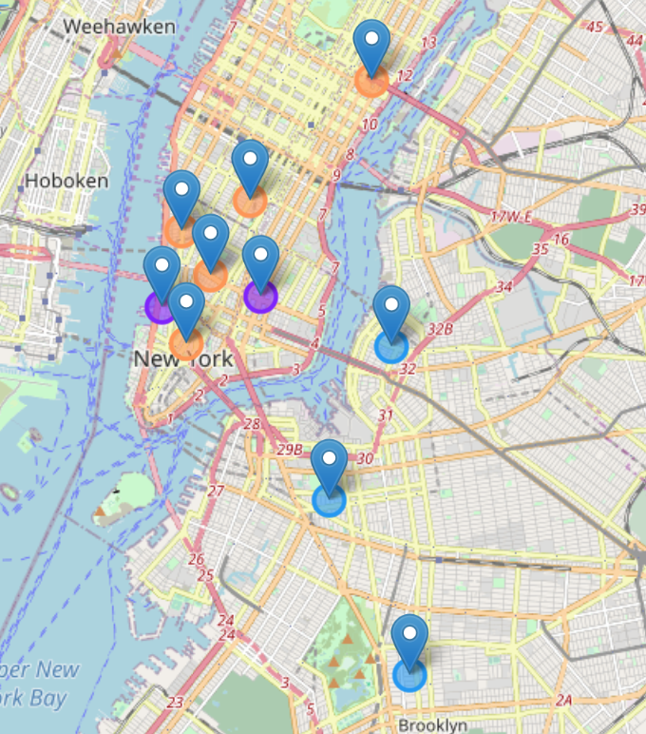
Zoomed View

